Slide 1

Sprocket Central Pty Ltd
Data analytics approach
Name – Mansi Patel

Slide 2
Agenda
Introduction
Data Exploration
Model Development
Interpretation

Slide 3
Introduction
Sprocket Central Pty Ltd is a long-standing KPMG client whom specializes in high-quality bikes and accessible cycling accessories to riders. Their marketing team is looking to boost business by analyzing their existing customer dataset to determine customer trends and behavior.
understanding the data distributions, feature engineering, data transformations, modelling, results interpretation and reporting

Slide 4
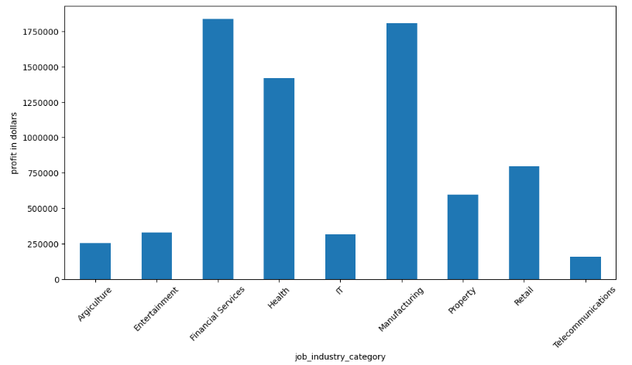
Data Exploration
Gender wise profit
Profit generated from females is slightly more compared to males.

Slide 5
Data Exploration
Job Industry wise profit
Financial Services, Manufacturing, and Health are the top three profit-generating industries, followed by retail and property.

Slide 6
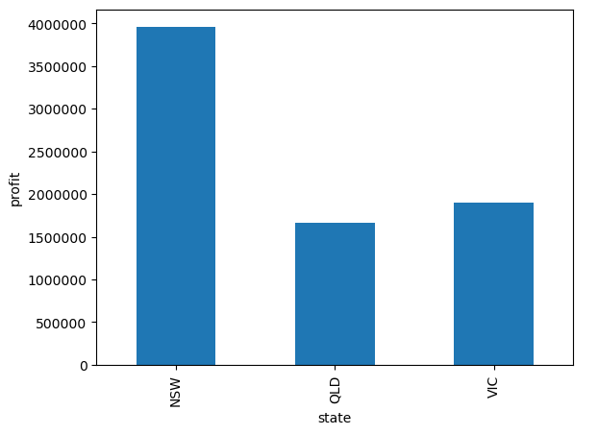
Data Exploration
State wise profit
Financial Services, Manufacturing, and Health are the top three profit-generating industries, followed by retail and property.

Slide 7
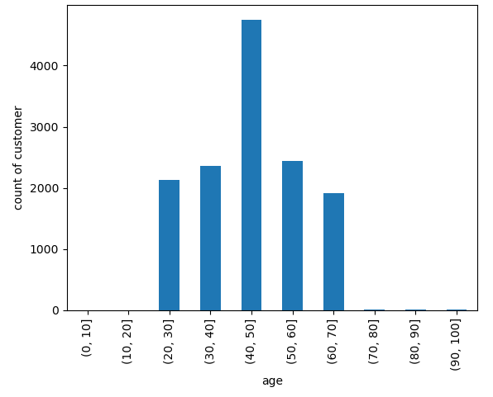
Data Exploration
Customer age distribution
Most of the customers are more from the age group of 40-50

Slide 8
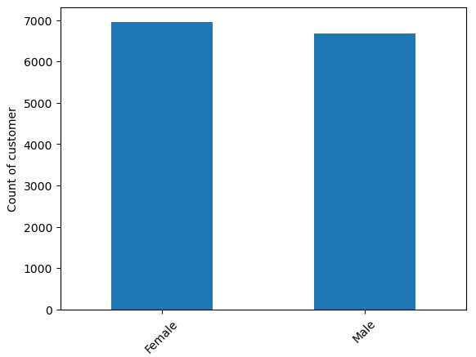
Data Exploration
Customer gender distribution
Female customers are slightly more than the male customers.

Slide 9
Model Development
RFM Analysis
RFM (Recency, Frequency, Monetary) analysis is a behavior-based approach grouping customers into segments.
It groups the customers on the basis of their previous purchase transactions. How recently, how often, and how much did a customer buy.
RFM filters customers into various groups for the purpose of better service. It helps managers to identify potential customers to do more profitable business.

Slide 10
Model Development
RFM Analysis
Recency (R): Who have purchased recently? Number of days since last purchase (least recency)
Frequency (F): Who has purchased frequently? It means the total number of purchases. ( high frequency)
Monetary Value(M): Who have high purchase amount? It means the total money customer spent (high monetary value)

Slide 11
Interpretation
RFM Score
Before calculating RFM score we calculate R,F,M score separately.
We assign score between 1 – 4 for each customer for r, f, and m score.
Customers with most recent purchase is assigned r score 1 and with least recent purchase is assigned r score 4.
Customers with high frequency of purchase is assigned f score 1 and with least frequency is assigned f score 4.
Customers with high monetary value is assigned m score1 and with least monetary value is assigned m score of 4.
At last we combine these three score to get the RFM score.
Customers with RFM score 111 are high value customers and customers with RFM score 555 are least valued customers.

Slide 12
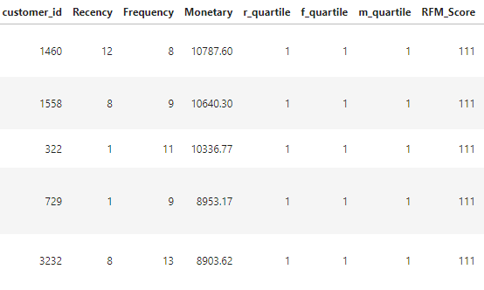
Results
Top 5 valuable customers based on RFM Analysis

Slide 13
Thank You

